Slide 1
专业英语 Professional English
主讲教师：车越岭

Slide 2
为什么要学这门课？ Why are students required to study this course?
Communication skills
交流和沟通能力是人的一种基本技能，对个人的健康生活和事业发展有重大影响。
Communication and Communication Skills are the basic skill of a person and has a major impact on an individual's way of life and career development.
交流和沟通能力对从事科学与技术的人的必备技能。
Communication and communication skills are essential skills for people engaged in the field Science and Technology
交流和沟通能力是人一生中要不断提升的技能。
Communication and Communication Skills are skills that people must constantly improve in their lives.

Slide 3
English Scientific Reading and Writing
英语是国际学术界的通用语言
English is the universal language of international academic circles
科技书籍、学术刊物、国际会议交流语言都用英语
Science and technology books, academic journals, and international conferences are all in English.
计算机科学的新成果和新技术往往有英文发表
New achievements and new technologies in computer science are often published in English
工具书、技术手册、说明书等都用英文
Reference books, technical manuals, manuals, etc. are all in English.
国际交流的通用语言 (Common language for international communication)
网上资料英文也很多 (Most Online information is in English)

Slide 4

What is this course about?
Written and oral communication is essential for exchanging ideas and thoughts, presenting coursework reports and research results, etc.
English is the most common language in international communication
Most commonly spoken foreign language: essential if you wish to publish your research results for international audience, study or work abroad, work in international business etc.
Most common language for scientific publications, technical reports and computer science literature
The aim of the course is to prepare you for expressing yourself in written and spoken English in real-life professional context.

Slide 5
Oral communication
Usually we need to present our research in a regular seminar or at a conference.

Slide 6
Written communication
Professional communication by e-mail etc.
Can be formal or informal, depends on how well you know the person, cultural considerations, whether it is private or group e-mail etc.
Memos and meeting minutes
Usually not strict formal requirements, format depends on the situation
Scientific reports and publications
There are general conventions and practices, often a template is provided
In popular science articles, more relaxed style allowed (targeted for the public)
Software/hardware documentation, user manuals
Usually very strict formal requirements, template is provided

Slide 7


Book Recommendation for Writing

Slide 8
考核方式(Assessment)
分组报告(Presentation)
分组论文(Paper)
平时成绩 (Assignments grade)

Slide 9
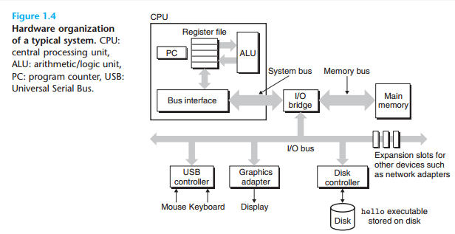
Class Task
Write an description for the following figure in 200 -300 words.
Title: The Hardware Organization of a System

Slide 10
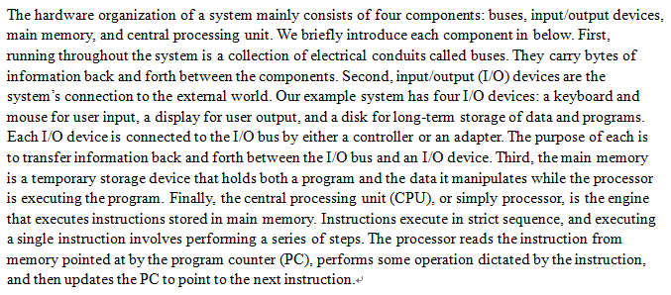
Class Task
Write an description for the following figure in 200 -300 words.
Title: The Hardware Organization of a System

